Slide 1
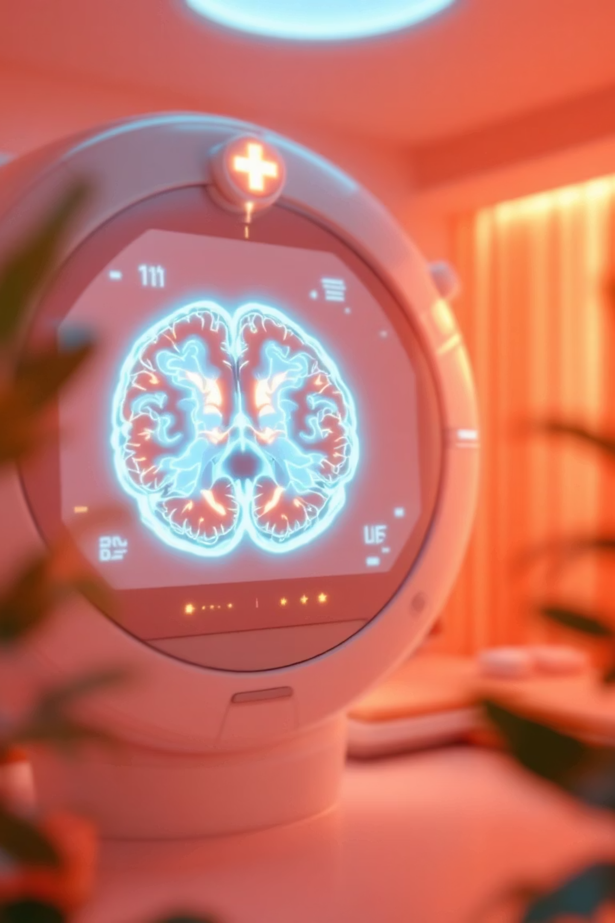
Retrospective Analysis of Brain MRI Images for Tumor Detection
Course: ISE 481 Biomedical Information Systems
Students: Mete Alper Tekce, Ekin Ada Özen

Slide 2
Presentation Agenda
01
02
03
Problem Definition
Study Design
Dataset Information
Clinical need for enhanced tumor detection
Retrospective analysis framework
Source and ethical compliance
04
05
06
MRI Physics
Methodology
Results
Imaging modality fundamentals
Image processing techniques
SNR improvements and comparisons
07
Conclusion
Key findings and references

Slide 3
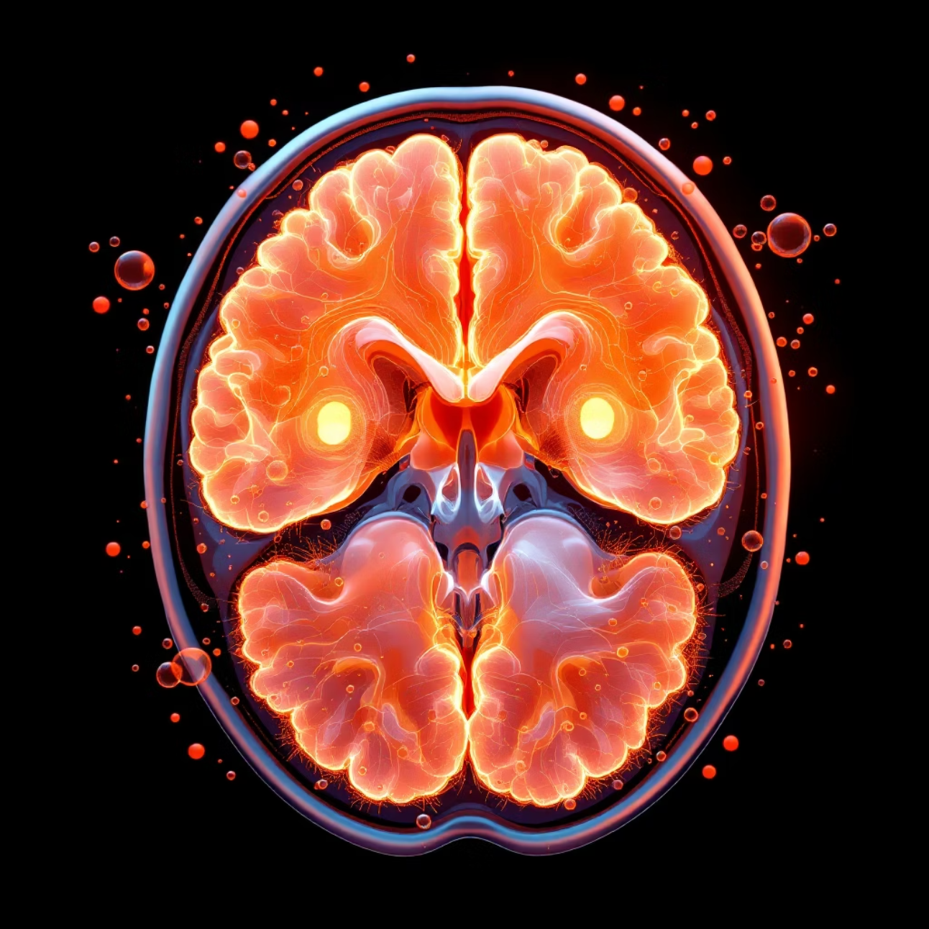
Problem Statement
Clinical Challenge
Brain tumors represent a critical health concern requiring early and accurate detection to improve patient outcomes. Timely diagnosis directly correlates with treatment efficacy and survival rates.
Technical Limitation
Raw MRI acquisitions inherently contain Rician Noise, a statistical artifact arising from the magnitude reconstruction of complex MRI signals. This noise can obscure subtle pathological features, potentially leading to diagnostic errors or delayed detection by radiologists.
Proposed Solution
Digital image enhancement techniques provide a computational approach to suppress noise while preserving anatomical detail, thereby supporting more confident radiological interpretation.

Slide 4
Study Design & Clinical Framework
Retrospective Analysis
Non-Invasive Imaging Modality
This study employs a retrospective design, analyzing previously acquired MRI datasets rather than prospective patient enrollment. This approach enables rapid hypothesis testing and algorithm validation using existing clinical data.
Magnetic Resonance Imaging (MRI) is classified as non-invasive because it relies on magnetic fields and radiofrequency pulses rather than ionizing radiation. This makes it particularly suitable for repeated imaging and pediatric populations.
Utilizes historical imaging records
No exposure to X-rays or gamma radiation
No patient recruitment required
Superior soft tissue contrast
Facilitates algorithm benchmarking
Safe for longitudinal studies

Slide 5

Dataset & Ethical Compliance
Data Source
Anonymization Protocol
Ethical Considerations
Dataset obtained from the public Kaggle Repository: "Brain MRI Images for Tumor Detection." This repository aggregates de-identified neuroimaging data suitable for machine learning and image processing research.
All imaging data has been rigorously anonymized to remove Protected Health Information (PHI), including patient names, dates, and institutional identifiers, ensuring full HIPAA compliance.
Use of publicly available, anonymized data eliminates the need for Institutional Review Board (IRB) approval while maintaining the highest standards of patient privacy and research ethics.

Slide 6
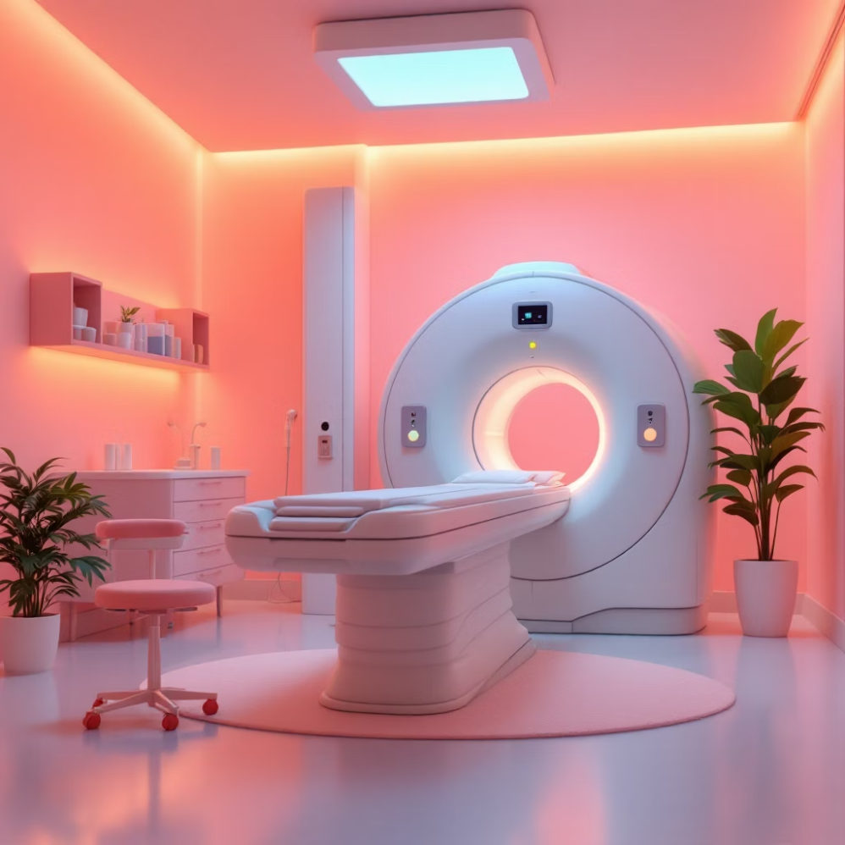
MRI Physics & Contrast Mechanisms
Fundamental Principles
MRI exploits the magnetic properties of hydrogen protons abundant in biological tissues. When placed in a strong magnetic field (typically 1.5-3 Tesla), protons align with the field. Radiofrequency pulses perturb this alignment, and the resulting relaxation signals are spatially encoded to reconstruct anatomical images.
Contrast Weighting
Different pulse sequences emphasize different tissue relaxation properties, generating T1-weighted or T2-weighted contrast. This flexibility enables visualization of both anatomical structures and pathological processes.
T1 vs T2 Contrast Comparison
Tissue Type
T1-Weighted Signal
T2-Weighted Signal
Cerebrospinal Fluid
Dark (Hypointense)
Bright (Hyperintense)
Gray Matter
Intermediate Gray
Intermediate Bright
White Matter
Bright
Intermediate Dark
Pathology/Edema
Dark to Intermediate
Bright (Hyperintense)

Slide 7





Algorithm Workflow
Load Image
Import raw MRI DICOM or standard image format into processing environment
Convert to Grayscale
Transform multi-channel data to single-channel intensity representation
Apply Gaussian Filter
Convolve image with 5×5 Gaussian kernel for noise suppression
Calculate SNR
Quantify signal-to-noise ratio improvement using standard metrics
Export Result
Save enhanced image for radiological review and validation

Slide 8
Methodology: Gaussian Filtering & SNR Quantification
Implementation Framework
Signal-to-Noise Ratio (SNR)
The image enhancement pipeline was implemented in Python using the OpenCV library (cv2 module), which provides optimized computer vision algorithms suitable for medical image processing.
SNR quantifies image quality by comparing signal strength to background noise level. It is defined as:
SNR = μsignal / σnoise
where μsignal represents mean intensity in the region of interest and σnoise represents standard deviation in a background region.
Gaussian Filtering (5×5 Kernel)
A Gaussian filter applies spatially weighted averaging, where pixel contributions decrease with distance according to a Gaussian distribution. The 5×5 kernel size balances noise reduction with edge preservation, critical for maintaining diagnostic features.
Quality Metric
Higher SNR values indicate improved image quality, with reduced noise facilitating clearer visualization of anatomical boundaries and pathological features. SNR improvement quantifies the effectiveness of the filtering operation.
Mathematical form: G(x,y) = (1/2πσ²)e^(-(x²+y²)/2σ²)

Slide 9

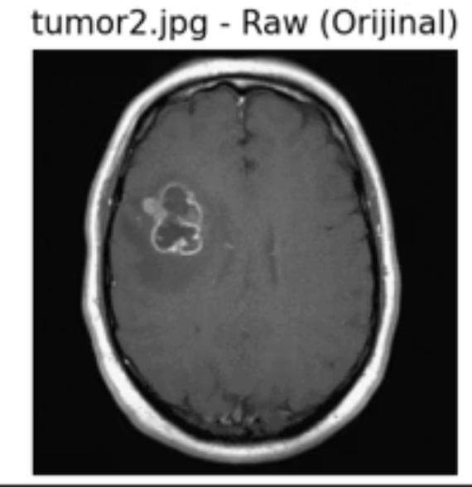
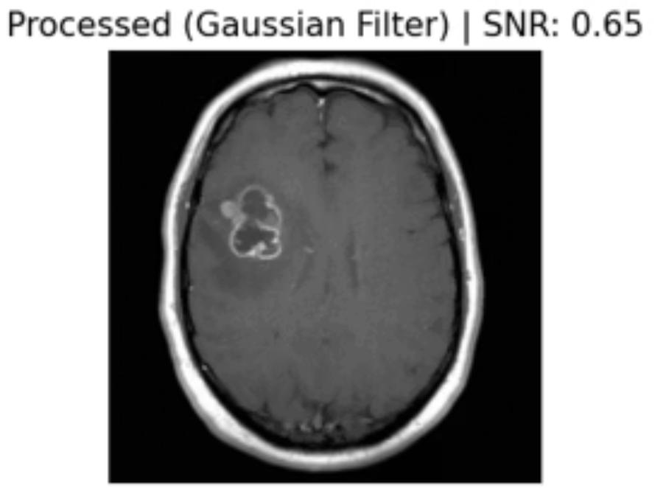
Experimental Results: Image Quality Enhancement
Visual Comparison
Raw MRI Image
Processed Image
Original acquisition with inherent Rician noise artifacts
Post-Gaussian filtering with enhanced tissue contrast
0.31
0.63
Normal Tissue
Tumor Case 1
SNR improvement in healthy brain parenchyma regions
SNR improvement in pathological tumor region, enabling clearer boundary delineation
The quantitative analysis demonstrates consistent SNR improvements across both normal and pathological tissues, with tumor regions showing particularly significant enhancement (102% improvement), facilitating more confident diagnostic interpretation.

Slide 10
Conclusion & Future Directions
Key Findings
Clinical Implications
Future Work
This project successfully demonstrated that Gaussian filtering significantly improves MRI image quality for brain tumor detection. The implemented Python-based pipeline reduced Rician noise while preserving critical anatomical features, with quantified SNR improvements supporting enhanced diagnostic confidence.
Enhanced image quality through computational post-processing can serve as a valuable diagnostic support tool, potentially reducing interpretation errors and facilitating earlier tumor detection. The non-invasive, retrospective methodology enables rapid validation and deployment.
Future investigations should explore advanced denoising algorithms (e.g., Non-Local Means, BM3D), integration with automated tumor segmentation pipelines, and validation on larger multicenter datasets to establish clinical utility and generalizability.
References
Kaggle Repository: "Brain MRI Images for Tumor Detection" - Public neuroimaging dataset for machine learning research
OpenCV Documentation (v4.x) - Computer Vision library for Python, official documentation and API reference
ISE 481 Biomedical Information Systems - Course lecture notes and laboratory materials, University curriculum

